Slide 1

St. Patrick’s Primary School
Primary 4
2025

Slide 2

Child Protection
Notes:
RM

Slide 3
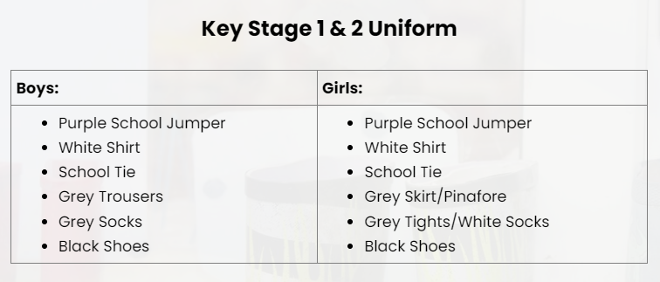

Expectations
Children in class at 08:50am.
Breakfast club begins at 08:00am if children wish to come in earlier.
Full school uniform each day – no earrings
Notes:
PS

Slide 4





Importance of school attendance
Importance of Attending School
To learn
Do better in tests and exams
Feel happier in school and have fun
Meet new friends and make new ones
Have access to school clubs, activities, and sports
Build confidence and be less anxious
Notes:
PS

Slide 5
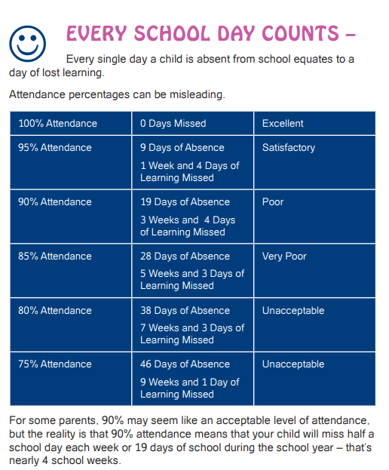
Attendance
Notes:
PS

Slide 6

Notes:
PS

Slide 7


Positive Behaviour Policy
Rewards – dojos, golden time etc.
Copy of policy from office – or school website.
Notes:
RM

Slide 8
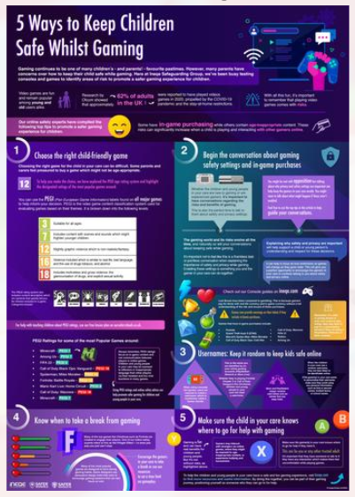

Safer Schools NI
Information on Safer Schools NI website about Instagram, snapchat, gaming etc.
There is an app you can download to keep informed.
Notes:
PS

Slide 9












The Preventative Curriculum
Pupil wellbeing is at the heart of all learning that takes place in St Patrick’s PS.
Our Preventative Curriculum provides pupils with the skills, attributes and resilience necessary to live successfully and positively in society.
Champions 4 Change (New Lodge Youth)
Weekly Award Celebration Assemblies
Head Teacher Award
Pupil of the Week
Maths Wizards
Hot Chocolate Friday
Grow in Love/PDMU
Notes:
PS

Slide 10
Literacy
Writing
We will cover a range of writing genres this year in school.
  Recount,
  Instructional,
  Non-chronological,
  Narrative writing and
  Explanation texts.
  Spelling
  In school, spelling activities will be completed 4 days a week in school. Children should practise spellings each night at home to prepare them for the Friday Quiz.
  Reading
  Guided Reading sessions take place each day in class. Children are regularly challenged and assessed, with assessments linked to Bug Club, e.g. comprehensions.
Notes:
RM

Slide 11
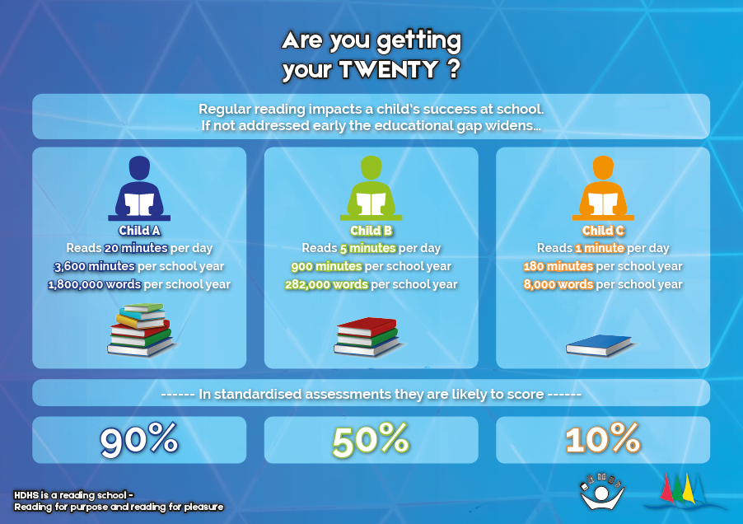
Notes:
RM

Slide 12
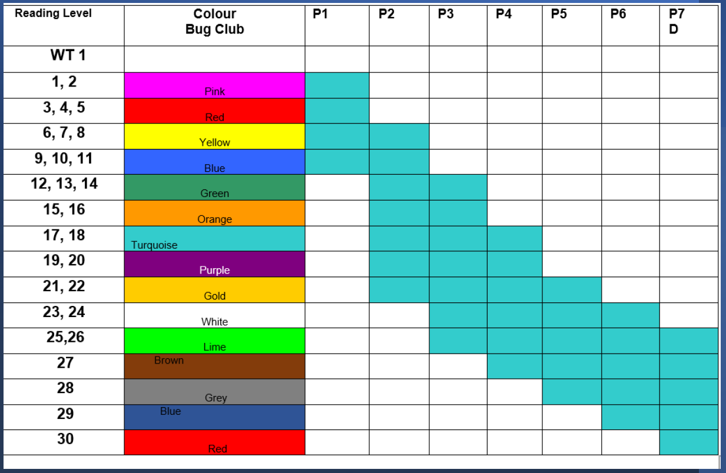
End of year reports will include reading level.
Notes:
RM

Slide 13

Numeracy
Focus
We will cover a range of topics this year in school, with our focus being number.
  Place Value within 1,000,
  Number facts,
  Addition and Subtraction and
  Multiplications and Division.
  Other
  We will also cover:
  Shape, Position and Movement,
  Time,
  Measurement,
  Information Handling and
  Money & Finance.
Notes:
PS

Slide 14
World Around Us
World Around Us
Term 1 | Them Bones, Them Bones
Term 2 | Houses and Homes
Term 3 | Weather Watchers
Projects
&
Trips!
Notes:
PS

Slide 15
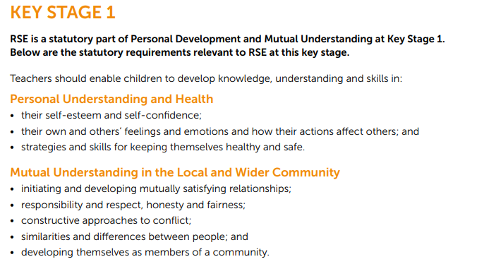
PDMU & RSE
  PDMU
Learning about my emotions and how to deal with them,
How to be a good friend and developing friendships,
Finding out about me as a person as I grow and
Bullying - how to recognise it and how to ask for help.
RSE
Notes:
PS

Slide 16


Grow in Love
Acceptance
Tolerance
Faith & Values
Awareness
Respect
Understanding
Notes:
RM

Slide 17
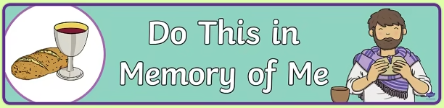
Do This in Memory & First Holy Communion
Do This in Memory Programme completed in partnership with school and home – mass one Sunday a month with parents.
Children will have a passport, that they can take to mass with them, and it will be signed by Fr Francis – what did I do/notice?
Meeting with Fr Francis in school on the 25th of September at 6pm.
Notes:
PS

Slide 18
Assessment
Assessments – ongoing throughout the year.
Reading levels – assessed three times a year.
End of year report 2026 will provide reading levels.
Bug Club Comprehensions.
Writing levels – three times a year.
One piece of writing shared with parents in Term 2 – two stars and a wish.
NGRT, NGST.
Numeracy assessment at the end of topics.
CCEA levelled maths tasks – twice a year.
PTM & PTE – end of May.
Notes:
PS

Slide 19
P.E.
P4RM | P4PS
PE: Tuesday (pitch) Wednesday (hall) | PE: Wednesday (hall) Thursday (pitch)
Full PE uniform: white polo shirt, black shorts or black tracksuit bottoms and trainers.
No jewellery or earrings permitted.
Notes:
RM

Slide 20
Homework
Both Literacy and Numeracy homework books should be returned to school each day.
Day | Homework
Monday | Literacy Homework: spellings and sentences. Bug Club or Reading Books - 20 minutes reading a night. Friday Quiz books sent home – return to school on Tuesday.
Tuesday | Literacy Homework: spellings. Bug Club or Reading Books – 20 minutes reading a night. Numeracy Homework: activity allocated on Seesaw – linked to previous weeks learning – complete in Numeracy Home Learning book.
Wednesday | Literacy Homework: spellings. Comprehension – allocated on Seesaw – complete in Literacy Home Learning book. Bug Club or Reading Books – 20 minutes of reading a night. Numeracy Homework: Timestables Rockstars.
Thursday | Literacy Homework: practise spellings using Look, Say, Cover, Write, Check for Friday quiz. Bug Club or Reading Books– 20 minutes reading a night. Grow in Love or PDMU: alternates each week. Will be allocated and completed on Seesaw.
Notes:
PS

Slide 21


Seesaw and Bug Club
Homework will be allocated on Seesaw each night – 30 mins max.
All homework will be completed in the Numeracy and Literacy Home Learning books, unless stated otherwise.
Bug Club should be accessed every night.
All codes for Seesaw and Bug Club are stuck in the children’s homework books.
If there are any issues with laptops or devices, please let the class teacher know.
Notes:
RM

Slide 22

Notes:
RM

Slide 23

Thinking School Accreditation 2025-2027
METACOGNITION AND THINKING MATTERS
Our learners will:
Become independent thinkers and problem-solvers, who listen and understand with empathy.
Collaborate, communicate, and reflect upon their learning with wonder and curiosity.
Make links across their learning.
Our learners will be able to understand and communicate their thinking processes, whilst understanding that learning can be difficult and see this as a journey.
Notes:
PS:
HOW DO WE TEACH METACOGNITION? Our staff actively teach our learners metacognitive strategies to help them be flexible and adaptable. To fulfil this, our aim is to ensure that every learner has the necessary skills and attributes to be successful in the next stage of their learning. All classrooms will consistently challenge learning through questioning and task design. Clear modelling of thinking processes, reflection and self-evaluation will be embedded in practice. Staff will provide learners with scaffolding tools and support learners in using them dependently and independently. They will provide learning experiences to support learners to Learning Habits develop a Growth Mindset with a 'can-do' attitude

Slide 24


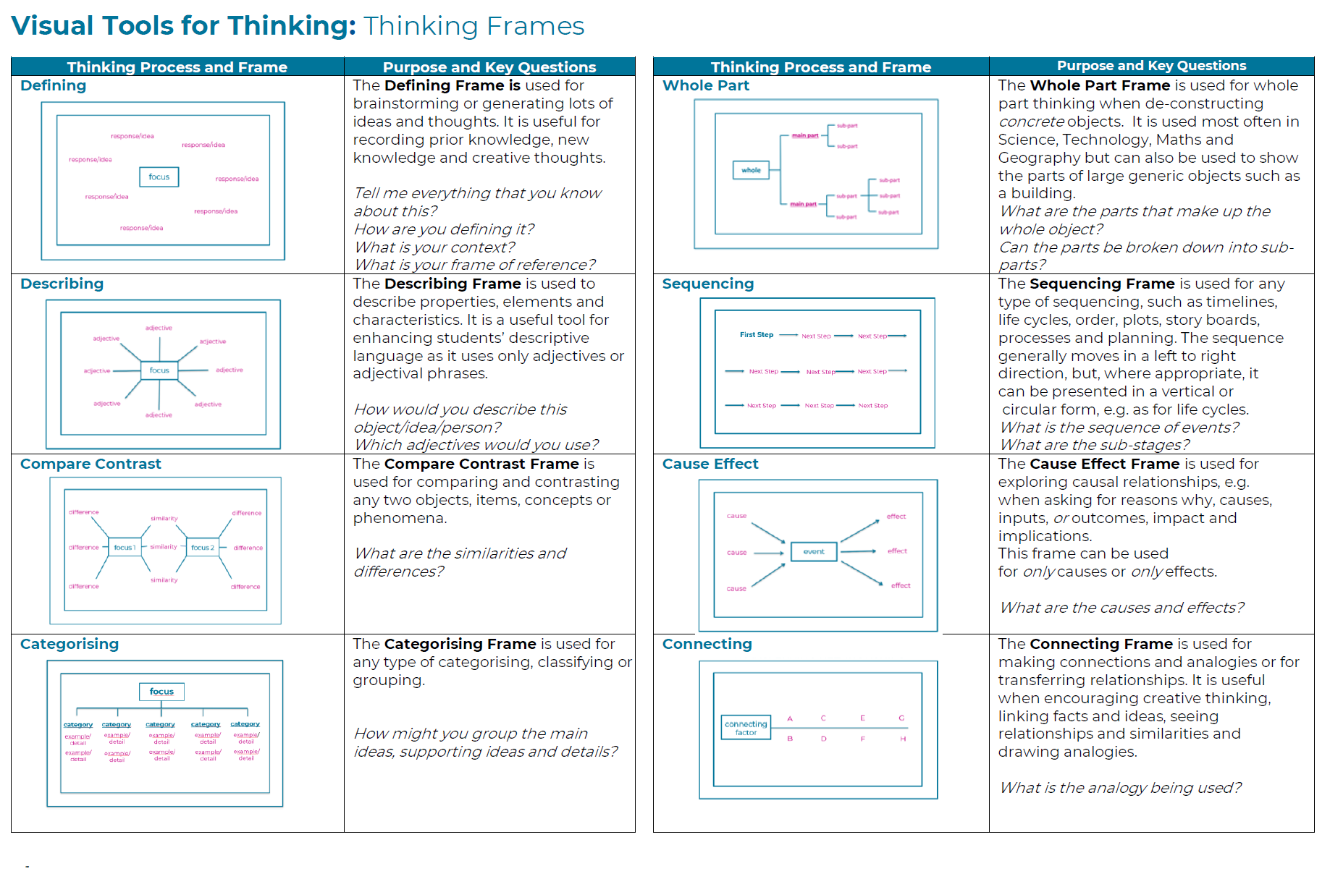
Thinking School

Slide 25
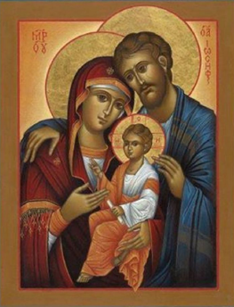
Special Dates
P4PS Special Assembly: Friday 5th December at 10am.
P4RM Special Assembly: Friday 27th February at 10am.
Notes:
RM

