Slide 1
St. Patrick's PS
P6 Curriculum

Slide 2
Overview
Important Dates
Homework Timetable & Examples
Assessment Cycle
End of Year Report
Literacy
Reading
Numeracy
World Around Us
P.E.
Religion

Slide 3
Important Dates
Special Assemblies:
  P6DN – Friday 14th November, 9am
  P6JT – Friday 5th December, 9am
Opening Mass:
Monday 22nd September

Slide 4
Homework Timetable
Monday | Bug Club | Spellings and Meanings | Mental Maths Sheet | Maths Topic Sheet
Tuesday | Bug Club | Spellings and Meanings | Mental Maths Sheet | Grammar activity
Wednesday | Bug Club | Spellings and Meanings | Mental Maths Sheet | Maths Topic Sheet
Thursday | Bug Club | Spellings and Meanings | Mental Maths Sheet | Comprehension

Slide 5
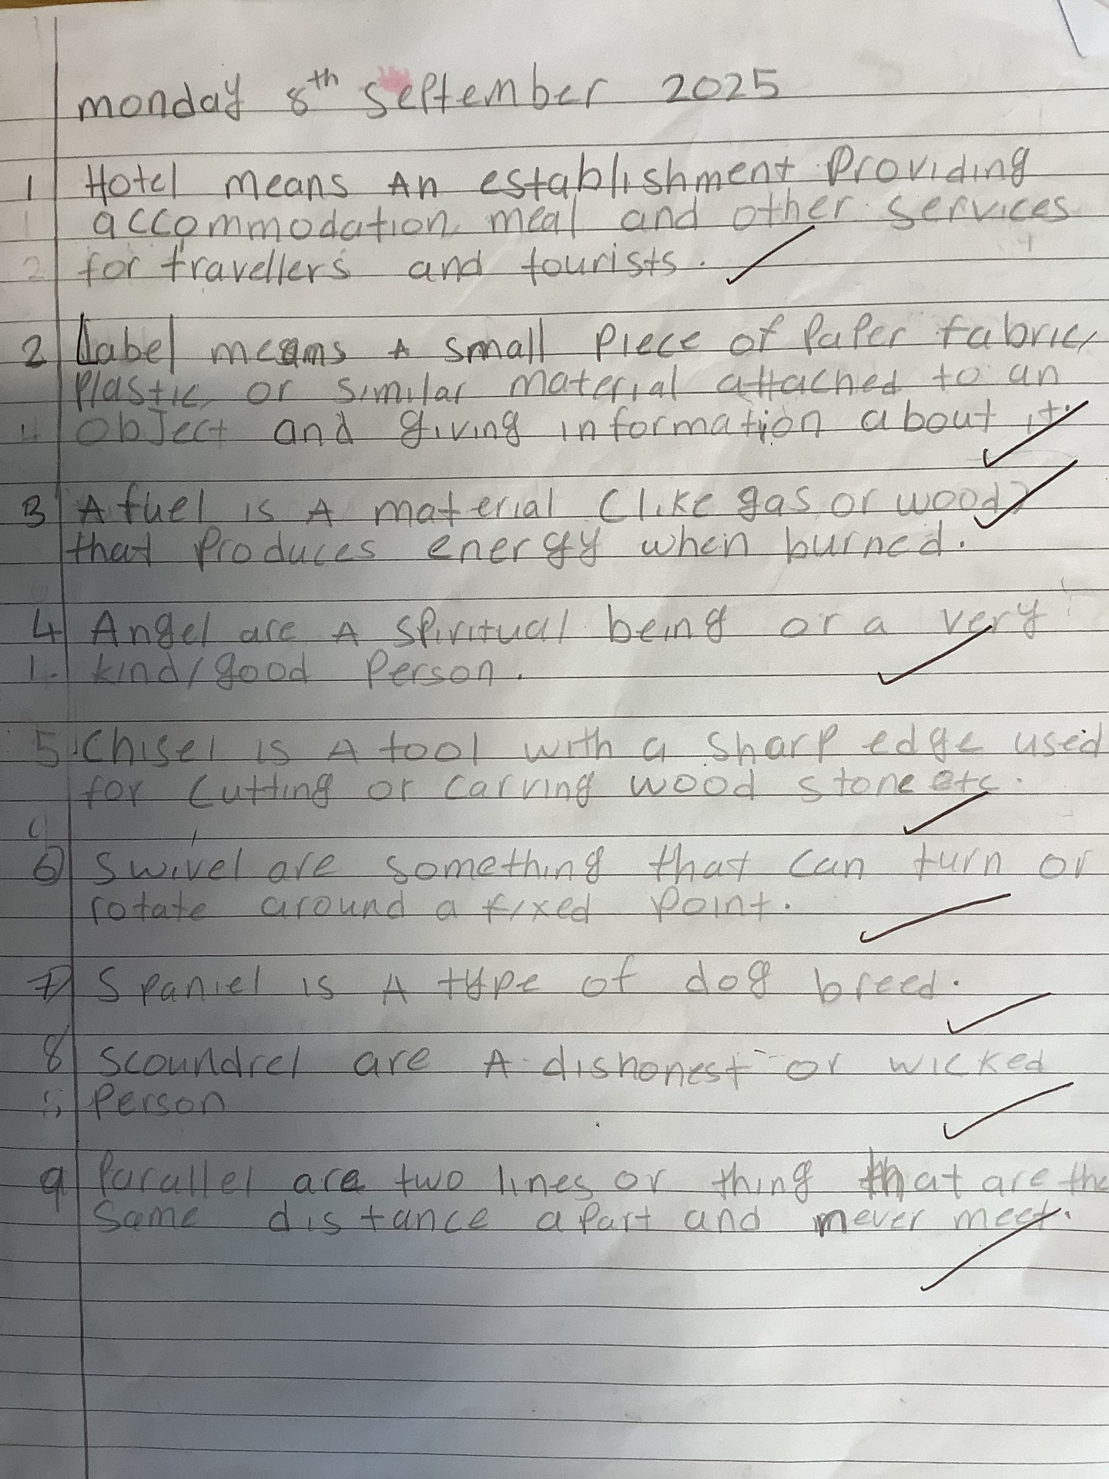
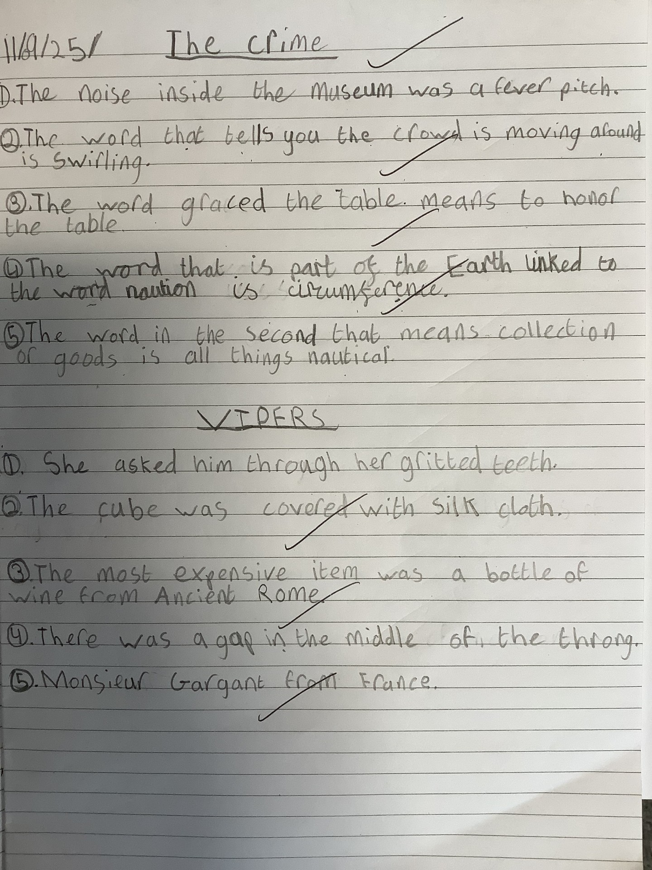
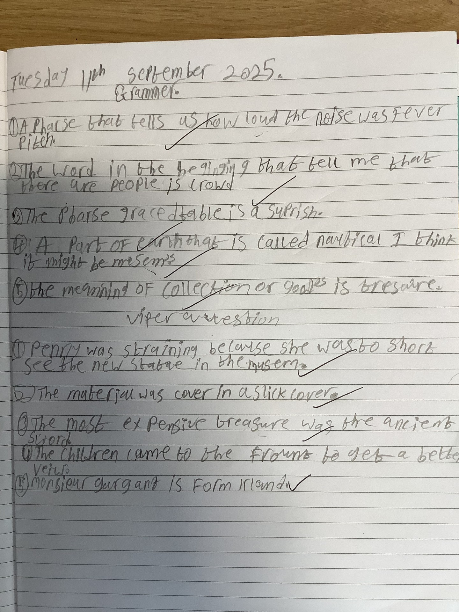
Examples of Homework

Slide 6
Assessment Cycle – Term 1
September | NGST NGRT
October | Progress & Assess Comprehension CEFR
November | Numeracy - Arithmetic & Reasoning Assessment ICT Assessment Writing Assessment

Slide 7
End of Year Report – Standardised Scores
Standardised Test | Standardised Score | Description | Achievement in relation to ability
Progress Test in English | 101 | Average | Expected
Progress Test in Maths | 95 | Average | Above Expected
New Group Reading Test C | 104 | Average | Expected
Description | Very low | Score of 73 and below | Achievement
 | Below average | Score of 74-88 |  | Lower than expected
 | average | 89-111 |  | Expected
 | Above average | Score of 112-126 |  | Above expected
 | Very high | Score of 127 and above

Slide 8
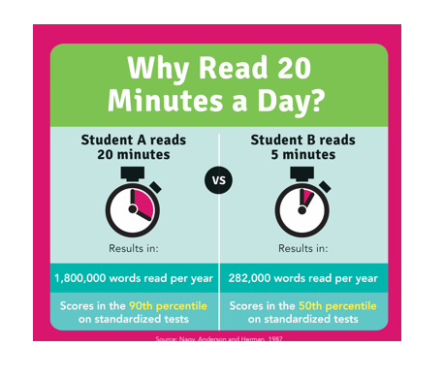

Literacy
The magic number is 20
Bug Club
Library
Literacy Shed

Slide 9
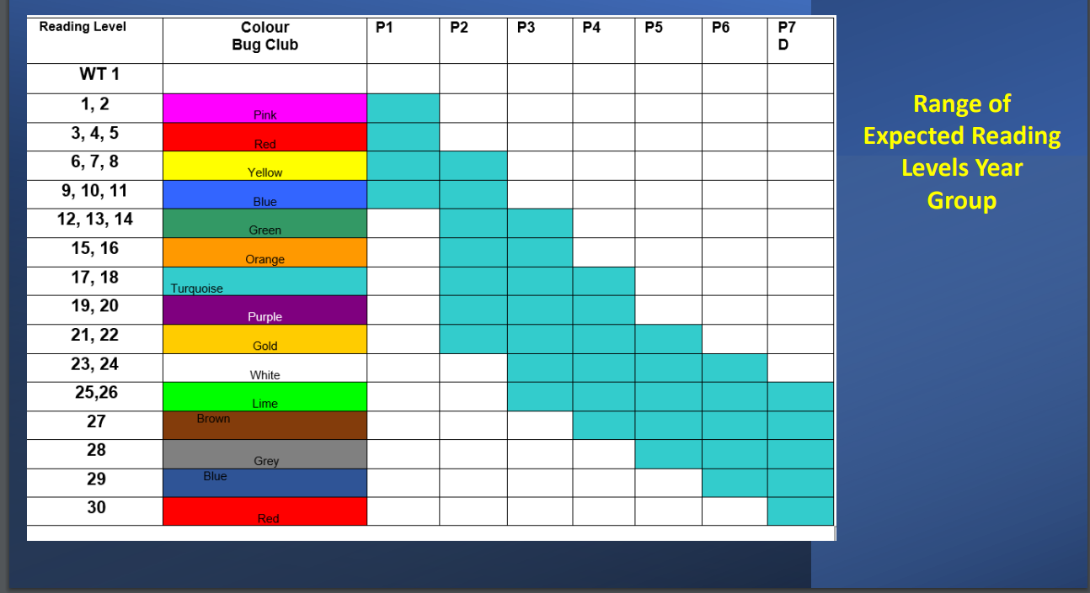

Slide 10

Numeracy
Power Up: Warm Up
Discover: Relating problems to the real world
Share: Discuss & Explain
Think Together: Paired & Group Work
Practice: Independent Work
Challenge and Reflect: Lessons conclude with a challenge question and an opportunity for students to reflect on their learning

Slide 11
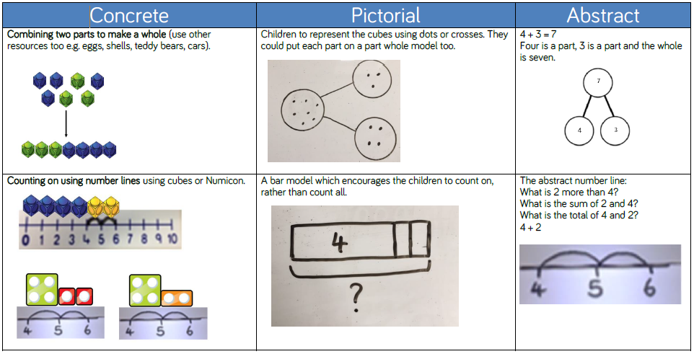
Examples of Calculations

Slide 12

World Around Us
Traders and Raiders – The Vikings
Curriculum Focus
A fun and collective approach to learning
Research
Presentation
Practical Learning
STEAM Projects
Who Am I?
PDMU
Art
Self - Development
Impact - Rainforest
Flight – Let Go, Let Fly

Slide 13


Slide 14


Slide 15
Special Assemblies
P6DN –Friday 14th November @9 am
P6JT – Friday 5th December @ 9 am

Slide 16
Mass
At St. Patrick’s Chapel with Fr. Francis O’Brien.

Slide 17
Thank You For Attending!

